Slide 1


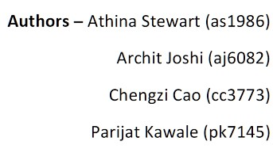
MyAnimeList

Slide 2
Overview of Data
- MyAnimeList is the world's largest anime and manga database and community.
- From Kaggle we were able to obtain data regarding the users, anime and the watchlist for each user.
- The Global anime market size was valued at USD 28.61 billion in 2022 and is expected to grow.
- Given the amount of media consumption by public today, we believe this data is beneficial to studio executives and general public alike when it comes to deciding what to watch next as well as strategic decisions such as which genres would profit more among what audience.

Slide 3
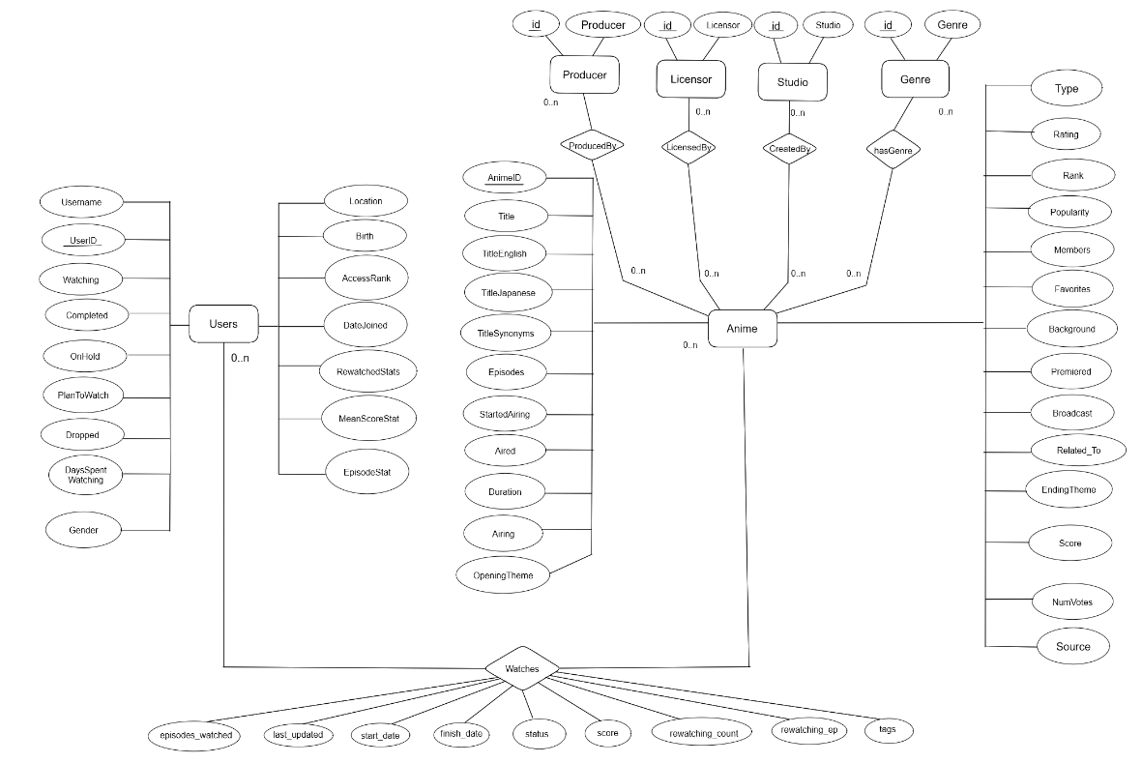
ER-Diagram
Notes:
Give a general description of the ER diagram.
How we had only 3 files but we split them into multiple relations to adhere to an entity relation model and to normalize the data.

Slide 4
Normalizing the Data
Functional Dependencies
anime_id -> title, title_english, title_japanese, title_synonyms, aired, aired_from_to, duration, isAiring, rank, popularity, members, favorites, background, premiered, broadcast, related_to, opening_theme, ending_theme, score, num_votes
user_id -> username, gender, birth, user_watching, user_completed, user_onhold, user_dropped, user_plantowatch, user_days_spent_watching, user_location, access_rank, join_date, stats_mean_score, stats_rewatched, stats_episode
genre_id -> genre
producer_id -> producer
licensor_id -> licensor
studio_id -> studio
user_id, anime_id -> my_watched_episodes, my_start_date, my_finish_date, my_score, my_status, my_rewatching, my_rewatching_ep, my_last_updated, my_tags

Slide 5

Document Database model
We ended up using MongoDB creating two collections:
Animes:
Details about anime such as title of the anime, the theme songs, duration of the anime , the producer, licensor and distributor of the anime.
Users:
Details about the users on myanimelist.net including their date of birth, location, count of animes completed, days spent on anime , number of animes currently being watched
Notes:
We thought about using mongodb to test the waters
Used 2 collections : Animes and Users
Animes is basically all the details about an anime
Users is details about all the users on myanimelist.com

Slide 6
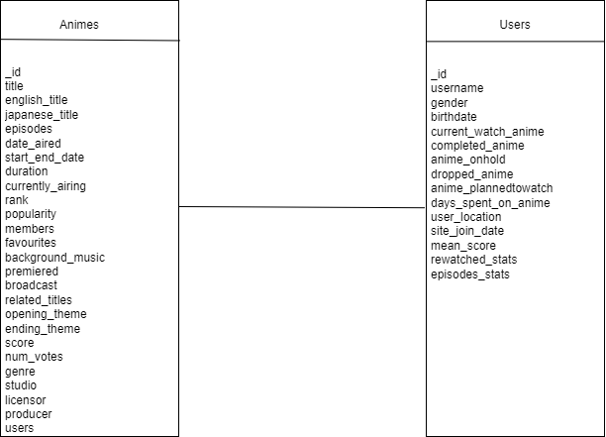
This is what our model looks like…
Notes:
Explain the schema in short
End with : So, the million dollar question , Was it helpful to use mongoDB?

Slide 7

Did it improve the performance?
No, the total time taken to insert data into MongoDB was more than 3 hours compared to 45 mins in relational database.
It was harder to extract particular fields using more complex queries resulting in higher delay in performance time.
Notes:
No it was not
Data preprocessing had to be done using python
We saw the data loading time was higher compared to the postgres.
And similar to the image, finding specific content in mongodb ..
Well , all in all , the queries were complex which delayed the overall performance

Slide 8
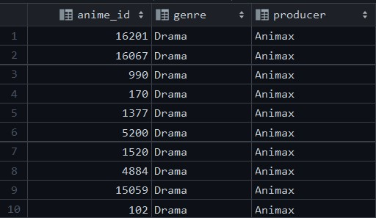
So you want to know what you can get out of this data ?
“Hmm, i'm a big drama anime fan, i want to invest in Animax (because it sounds cool) but i wonder how many drama animes have they produced…”
… turns out only 10
Notes:
To inference how this data can help make strategic choices towards targeting consumers here are some interesting queries.

Slide 9
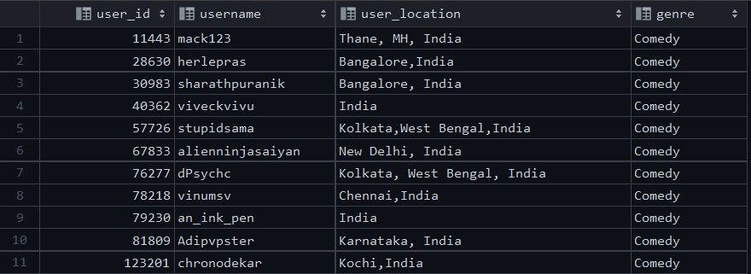
“India seems like a growing market for animes, maybe I’ll have a focus group for users who watch comedy animes from India. I should probably get their details…”

Slide 10
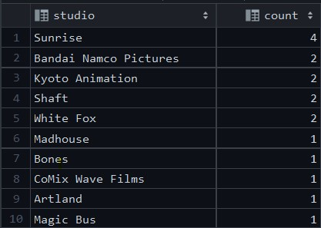

“I have a really good story, but i want a studio which has produced the most highest ranking animes to produce it .. “

Slide 11
But there are also a few issues in the data
A lot of the issues in the dataset stem from lenient fact checking during user sign ups.
The noticeable errors included -
Completeness -> Some address, gender, location data for users is incomplete
Uniformity -> Runtime for episodes is in hours as well as minutes.
Accuracy -> Fake birthdates for user profiles to bypass age restricted content.
Validity -> Invalid values for usernames and addresses for users.

Slide 12
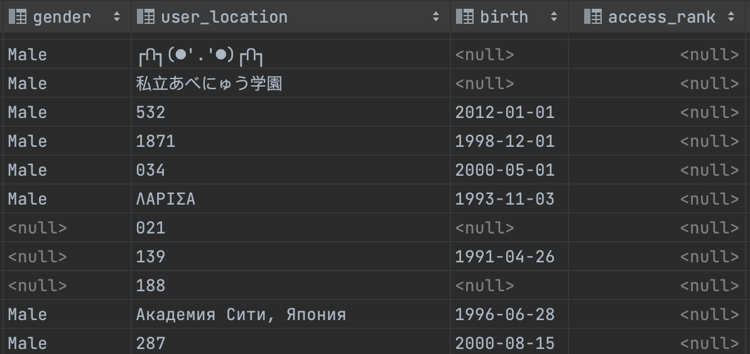

Data Cleaning + Integration
Notes:
TRANSFORMATIONS TO DATA
Based on our observations (which let to out relational diagram), there were many-to-many relationships among producer-anime, licensor-anime, studio-anime and genre-anime. As such, these were split into their own tables and multiple column foreign keys were used to relate the licensors, producers, studios and genres to the anime.
FILTERING
Removed null entities from the gender, birth date and location columns
CLEANING
Truncated all users who have watched more episodes of an anime then actually exists for that anime. Example of incorrect data
Truncated users that were too young or too old. Casted as date type first. Example of invalid data.
Users can input their location (leading to some wild descriptions). One way to clean was to constrain entries to be letters only. Example of invalid data
Truncated users who reportedly spent more days watching anime than possible for the average human lifespan (limit sent to 50 years). Example of incorrect data
Added primary keys to the user and anime table to prevent having empty rows
Added functional dependencies in all relation tables to prevent having duplicate rows
Empty columns: access rank and related as (deleted these rows)
Truncated anime that had 0 episodes (invalid data)
Truncated users who watched less than 1 episode (invalid data)

Slide 13
Our data can also give you some statistics if you’re into math. . .

Slide 14
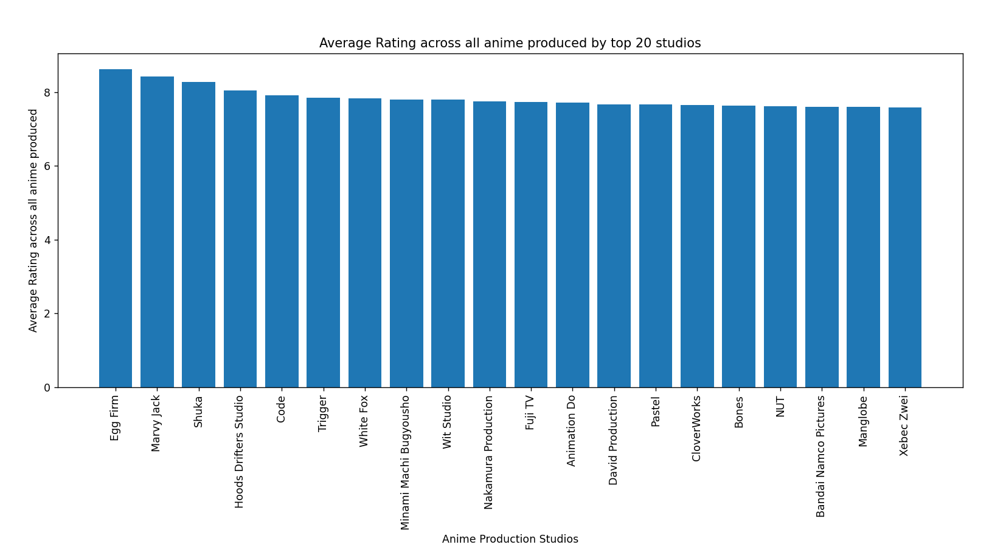
Notes:
Gives us the average rating across all animes produced by top 20 studios -
Query :
select studio.studio , avg(a.score) as average_rating
from studio
inner join created_by cb on studio.studio_id = cb.studio_id
inner join anime a on cb.anime_id = a.anime_id
group by studio.studio order by average_rating DESC limit 20

Slide 15
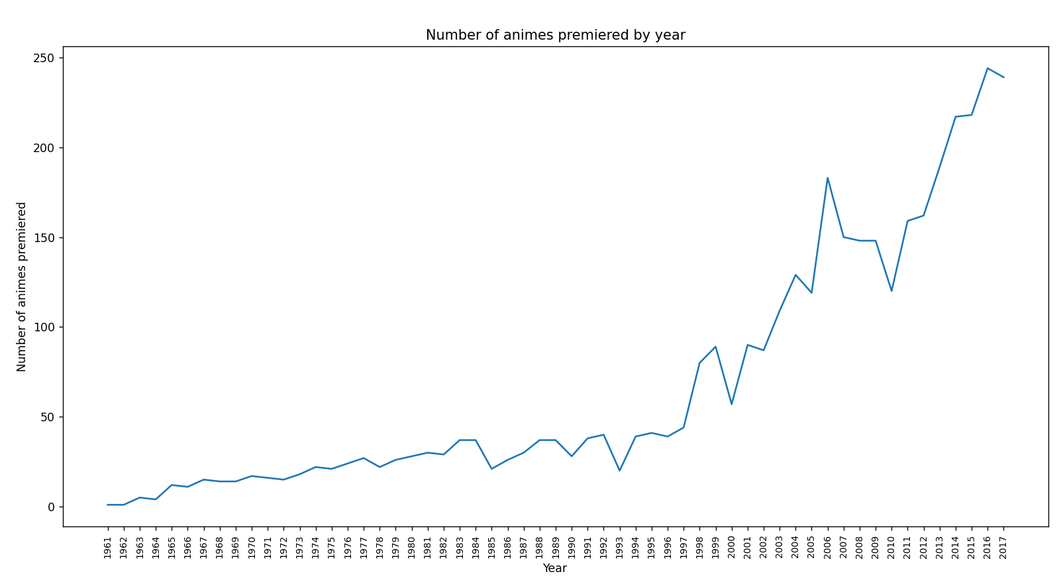
Notes:
As noticeable, in general the anime industry is a booming one with a generally consistent increase in the number of animes premiering over years.
Query -
select (string_to_array(premiered, ' '))[2] as year,
count((string_to_array(premiered, ' '))[2]) as count
from anime
where (string_to_array(premiered, ' '))[2] is not null
group by (string_to_array(premiered, ' '))[2] order by (string_to_array(premiered, ' '))[2]

Slide 16
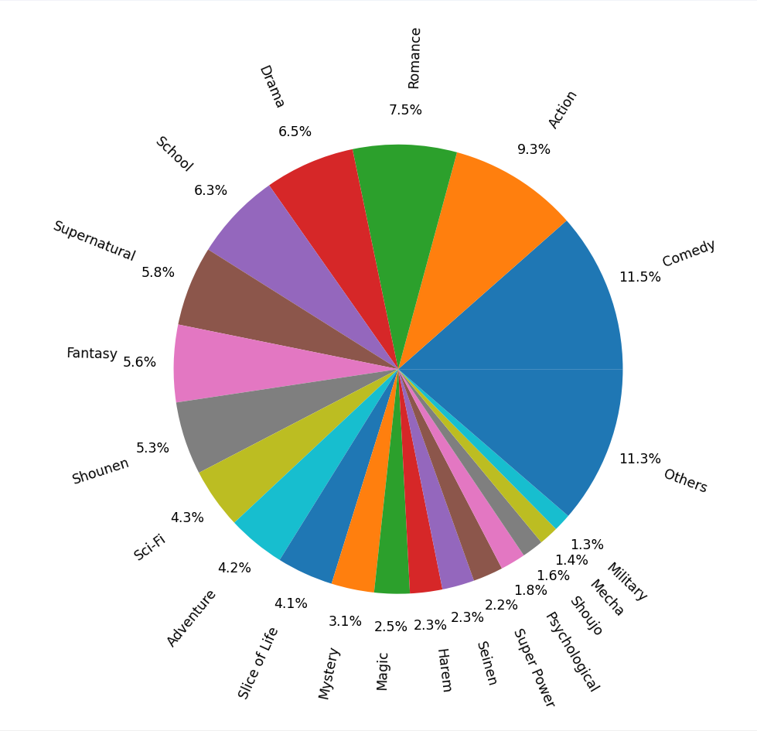
Notes:
It can also help us understand what genre of anime is watched the most by users.
Query -
select distinct count(anime.anime_id), genre
from anime
inner join has_genre hg on anime.anime_id = hg.anime_id
inner join genre g on hg.genre_id = g.genre_id
inner join watches w on anime.anime_id = w.anime_id
group by genre
order by count(anime.anime_id) DESC

Slide 17
Turns out we can also predict what genres go together in an anime . . . .
Genre 1 | Genre 2 | Genre 3 | Genre 4
Adventure | Comedy | Fantasy | Kids
Adventure | Comedy | Fantasy | Action
Adventure | Comedy | Fantasy | Shounen
Action | Adventure | Comedy | Sci-Fi
Action | Adventure | Comedy | Fantasy
Action | Adventure | Comedy | Shounen
Comedy | Fantasy | Kids | Adventure
Shounen: a genre of Japanese comics and animated films aimed primarily at a young male audience, typically characterized by action-filled plots.
Notes:
Anime creators get to know the most popular genres of animes that go together.
Use apriori algo in MongoDB and PostgreSQL after data cleaning. With minimum support of 100. 4 itemsets and L4 has 7 results.
identify strong associations between genres. This can help in understanding how different genres are combined and how they complement each other in various anime titles.
Anime fans can have their preferences matched more accurately.

Slide 18

Document DB vs Relational DB ?

Slide 19


Notes:
We chose Relational database because …
Structured data
Query ease.Availability of joins, index(speed up up to 40%)
Accurate results: integrity constraints and normalization techniques
ACID-compliant: atomic, consistent, isolated, and durable, user-generated data
Document: higher level of control over the individual attributes of the row Scalable: no concern on attribute level validation when new data is inserted

Slide 20

Thank You !

